Slide 1
Adapter Design Pattern

Slide 2
Introduction
Facade design pattern is categorized under Structural design patterns.
he adapter pattern convert the interface of a class into another interface clients expect. Adapter lets classes work together that couldn’t otherwise because of incompatible interfaces.

Slide 3
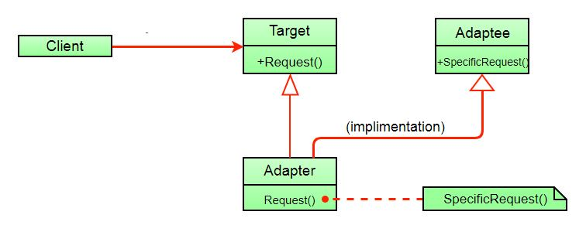
Problem Definition
An adapter can be used when the wrapper must respect a particular interface and must support polymorphic behavior.

Slide 4
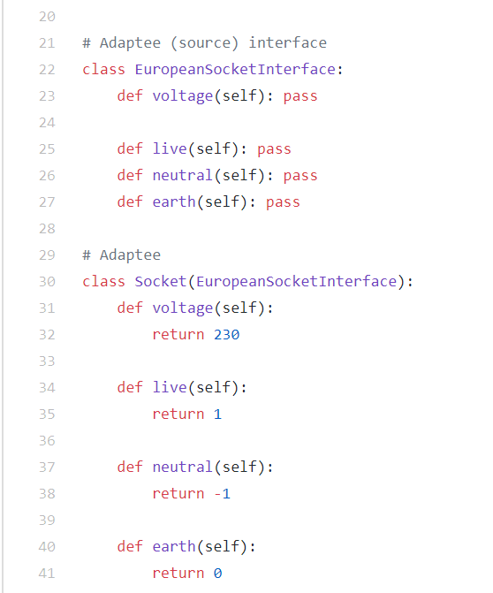

Slide 5
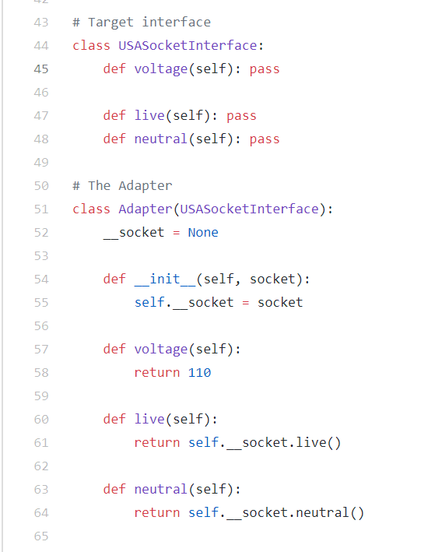

Slide 6
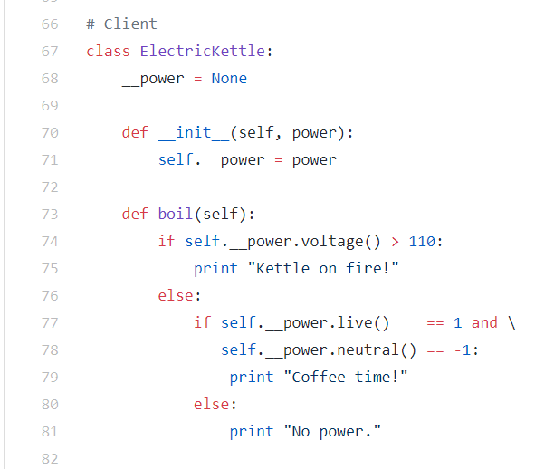

Slide 7
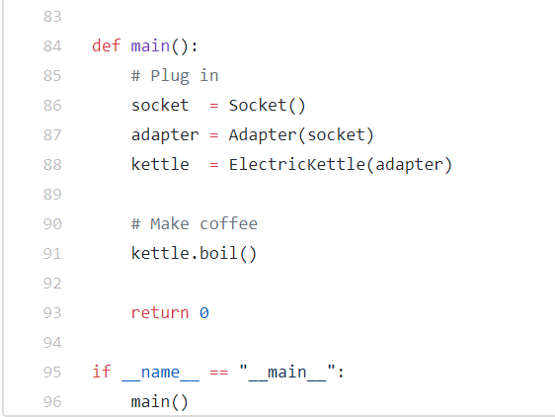

Slide 8
Disadvantages:
Sometimes many adaptations are required along an adapter chain to reach the type which is required.

